Slide 1
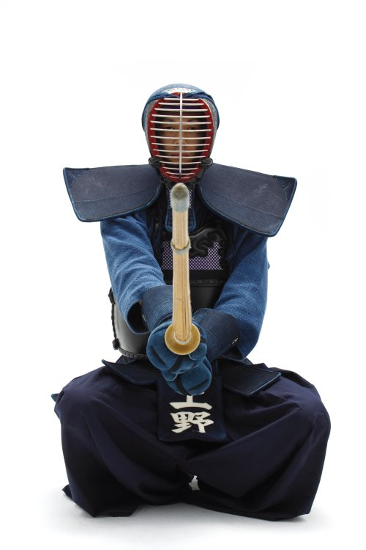
IR3535®:
Shield yourself against insects
Dr. AM Bohlmann

Slide 2
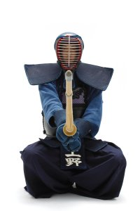


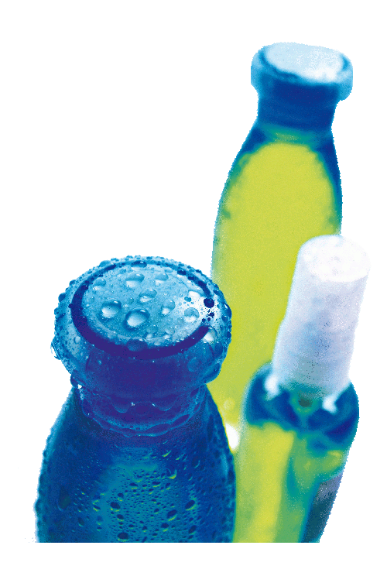
IR3535® the insect repellent
"Against insects
you better defend
yourself really effective"
Insect repellents are substances
applied to skin, hair, clothing, or other
surfaces (e.g. floor) which discourages
Insects from landing or climbing on that
surface.

Slide 3
IR3535® close to nature
IR3535® is
structurally similar to
naturally occurring
amino acid β-alanine -
an amino acid of human being
DEET and Picaridin do not
show structural similarity
with nature.

Slide 4
IR3535® excellent toxicological profile
EPA registration as Biopesticide
US-EPA classification:
IR3535® “is
practically non-toxic
to mammals including
infants
and children…”
Picaridin, registered pesticide:
“…does not present a health concern…”
DEET, registered pesticide:
“…does not pose a significant health risk…”

Slide 5
IR3535® excellent efficacy profile
Claims with
IR3535®:
Mosquitoes
Ticks
Lice
Stable flies
Black flies
Sand flies
Deer flies
Biting midges
House flies
Wasps
Bees

Slide 6
IR3535® excellent efficacy
In May 2008, the
US-CDC
recommended the use of IR3535®:
“products containing these active ingredients typically provide reasonably long-lasting protection”.
CDC, Centers for Disease Control
www.cdc.gov/ncidod/dvbid/westnile/repellentupdates.htm.

Slide 7
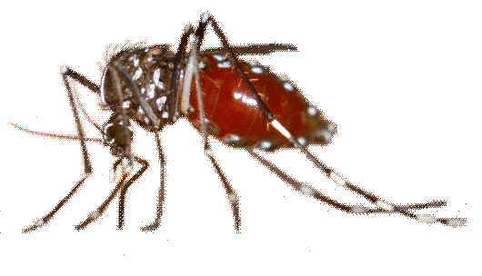
IR3535® latest study with mosquitos
Study Type
Field Test (USA)
Test Formulation
20 % IR3535® Spray
10% IR3535® Lotion
Conditions
10 Volunteers,
0,001 ml lotion / 0,0006 ml
spray per cm2
measurement: first
confirmed landing with
intent to bit (LIBes)
Species
Aedes, Culex and
Anopheles species
Conducted
under the authority of
US-EPA
Mean protection times
of more than 7 and 8 hours
Carroll (2008) Prolonged efficacy of IR3535 repellents against mosquitoes and blacklegged ticks in North America. J. Med. Entomol. 45(4):706-714.

Slide 8
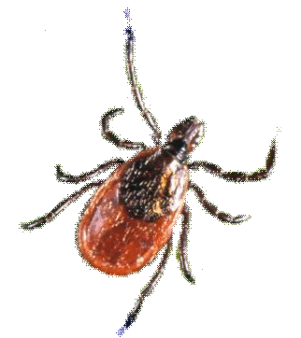
IR3535® latest study with ticks
Study Type
In-vivo human skin test (USA)
Test Formulation
10% IR3535® Lotion
20% IR3535® Spray
20% IR3535® Aerosol
Conditions
10 Volunteers,
0,001 ml lotion or aerosol /
0,0006 ml spray per cm2,
measurement: cross to
treated area more than
3 cm toward the elbow
within 3min /
1 tick per single
exposure period.
Species
Ixodes scapularis (nymphal)
Conducted
under the authority of
US-EPA
Mean Complete Protection Time (CPT)
between 9 and 12 hours
Carroll (2008) Prolonged efficacy of IR3535 repellents against mosquitoes and blacklegged ticks in North America. J. Med. Entomol. 45(4):706-714.

Slide 9
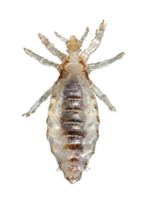
IR3535® latest study with lice
Study Type
Randomised comparative
bio-clinical in vivo trial,
in double blind
Objective
Measurement of
re-infestation in
two groups
Test Groups
20 % IR3535® Spray
Placebo spray
Conditions
Randomization of 40
Children in each group
Species
Head Lice
(Pediculosis capitis)
Significant lower lice number In IR3535® group after 9 days
Investigators:
C. LANG-COMBESCOT
F. MILITÄO DE SOUSA
AW VASCONSELOS
S SÁ PREIRE MILITÄO
J ROUSSE
62
26
14
2

